Slide 1
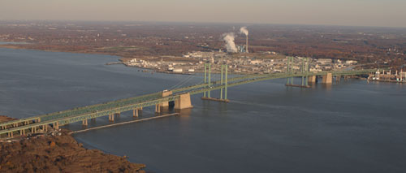
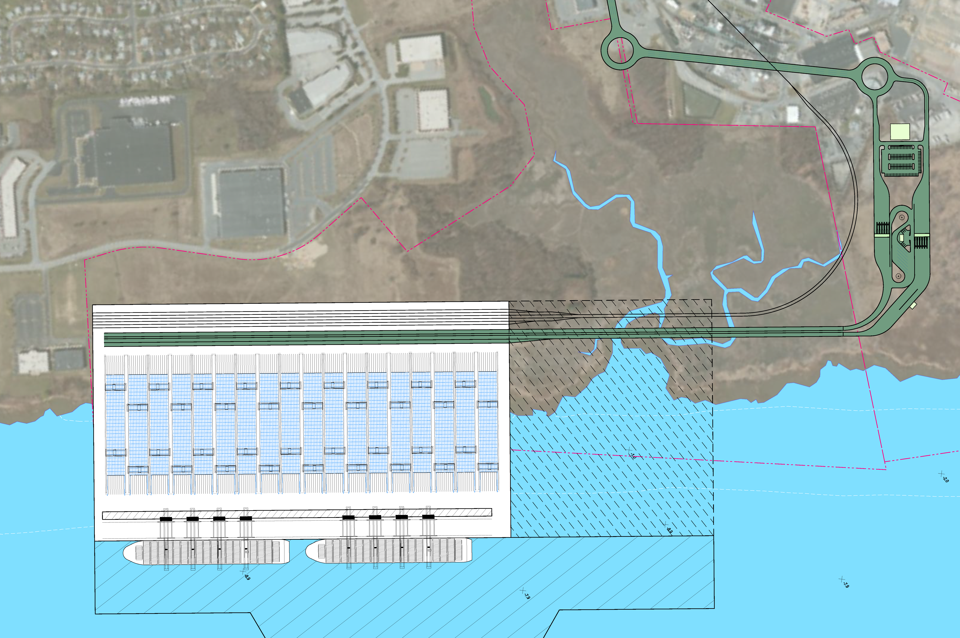
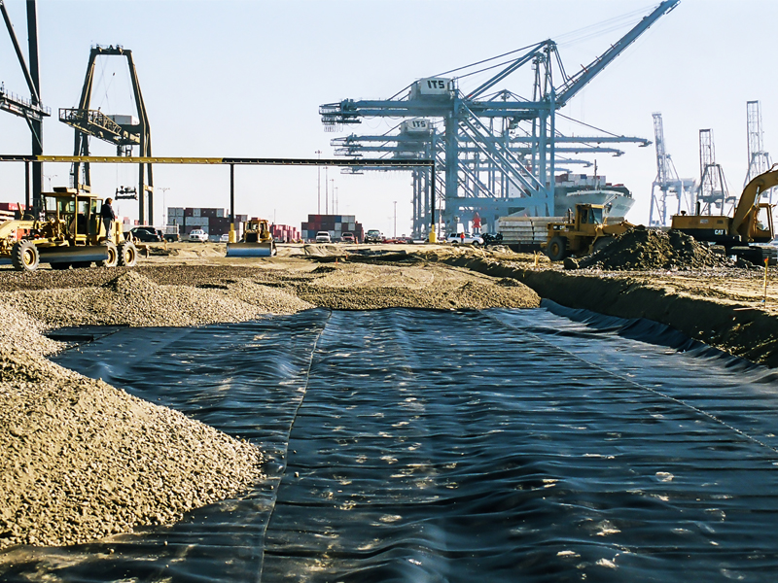
A BRIEFING TO THE PORT OF WILMINGTON EXPANSION TASK FORCE State Representative Charles Potter, Jr./Co-Chair State Senator Margaret Rose Henry/Co-Chair
The RiverEdge Container Terminal Project
May 23rd, 2016
©2016 Paul F. Richardson Associates, Inc.

Slide 2
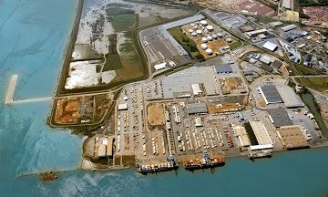
Recently, the Diamond State Port Corporation (DSPC) released findings for its Strategic Master Plan.
Paul F. Richardson Associates, Inc. (PFRA) assisted in developing the plan.
The document confirmed that the current port configuration has capacity constraint.
Among other things, the report clearly demonstrated the need for the DSPC to consider alternative new sites “along the Delaware River”.
Importantly, the analysis also identified that there is “optionality” for the Stakeholders.
Options which are not mutually exclusive.
©2016 Paul F. Richardson Associates, Inc.

Slide 3
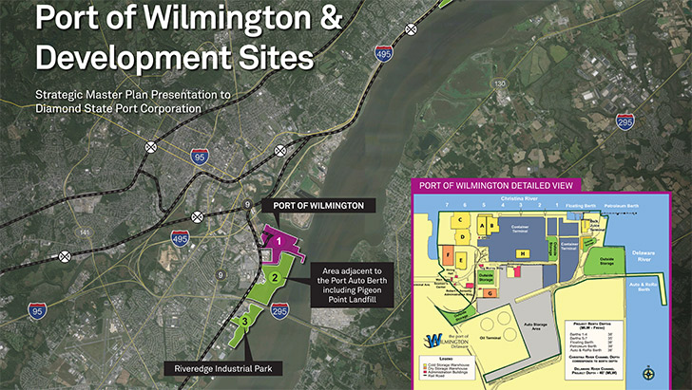
The DSPC Strategic Master Plan included analysis on the following sites.
Edge Moor
©2016 Paul F. Richardson Associates, Inc.

Slide 4
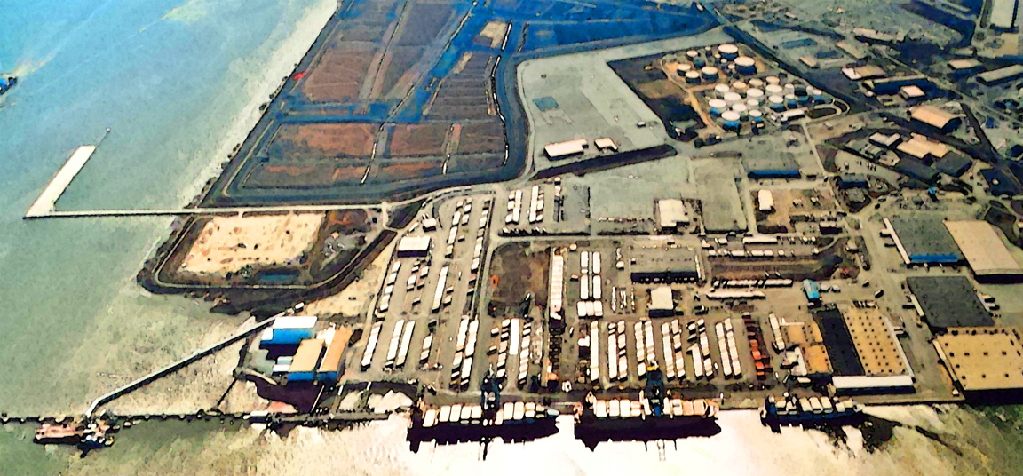
The DSPC Strategic Master Plan created the following scenarios or “options” to help guide the Stakeholders in their decision process.
Alt 1
State of Good Repair & Commitments
$185m
Alt 1A
Capacity Addition to Accommodate to 2035
$145m
Alt 2
Alternative new Capacity $491m - $1,094b
Alt 2B
Wilmington Harbor South (WMS) River $1,094b
Alt 2C
Wilmington Harbor South (WMS) Land $493m
Alt 3
RiverEdge Container Terminal Project $650m - $882m
Alt 4
Edge Moor Site/Project $491m
©2016 Paul F. Richardson Associates, Inc.

Slide 5
The DSPC Strategic Master Plan also acknowledged two (2) very critical items:
The need to “move ahead” on finding an alternative site(s) for Dredge Management Material Plan (DMMP) that now takes place at WHS.
All of the options require this action to varying degrees.
The State of Delaware and the Stakeholders are likely to have to partner with private investment to expand with any one (or more) of the alternatives or “options”.
©2016 Paul F. Richardson Associates, Inc.

Slide 6
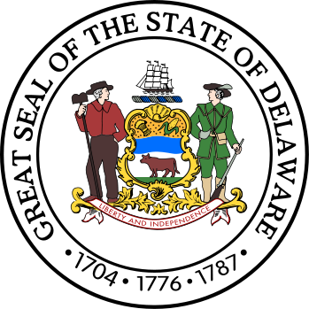
How are these options beginning to “fall out” after the DSPC Strategic Master Plan effort?
Existing DSPC Facility and WHS
Built in the 20’s with an incremental approach which is expensive to maintain and grow.
Has existing customer base which needs to be serviced that includes container, breakbulk and bulk.
Has contiguous lands and should be pursued.
Edge Moor
Gives optionality as potential moderate container site which may be more strategic for the State of Delaware and private investors to pursue instead of “sinking additional” expense at existing DSPC facility.
A better value proposition?
RiverEdge
A “clean canvas”.
A state-of-the-art, best-in-class facility highly desired by the private investor because it creates its own set of options as to design, build and subsequent operation.
Creates long-term investor opportunity.
Not mutually exclusive but potentially “very compatible”
©2016 Paul F. Richardson Associates, Inc.

Slide 7
Another finding from the DSPC Strategic Master Plan is that the GM Boxwood site can play a very tactical role in both railroad and warehousing capability to all future options.
GM Boxwood Plant
495
DSPC Port of Wilmington
95
295
RiverEdge
Container Terminal Project
©2016 Paul F. Richardson Associates, Inc.

Slide 8
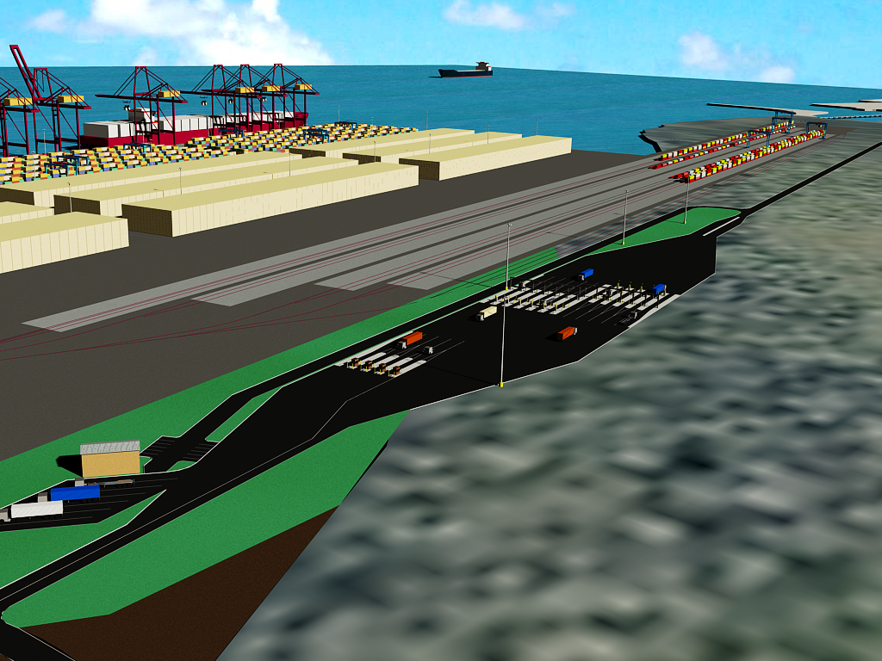
The road ahead to RiverEdge.
RIVEREDGE PROPONENTS
STATE OF DELAWARE
Start RiverEdge Assessment
Start DSPC Strategic Master Plan
Engage Investors/Stakeholders
Provide Professional Findings
DSPC Strategic Master Plan Findings
Maintain Investors/Stakeholders
Discussions
Engage in Discussions with
Investors/Stakeholders for all
project options
Provide further due diligence and assessments
For RiverEdge Container Terminal Project
to Investors/Stakeholders
Review strategic options relative to
DSPC Strategic Master Plan and
Investors/Stakeholders
Start formal Stakeholder Alignment and
begin relevant permitting process on WHS
Provide further due diligence and assessments
For RiverEdge Container Terminal Project
to Investors/Stakeholders
Create platform within State of Delaware which embraces
Public/Private Partnership
Engage in “Negotiations” regarding Transaction
©2016 Paul F. Richardson Associates, Inc.

Slide 9
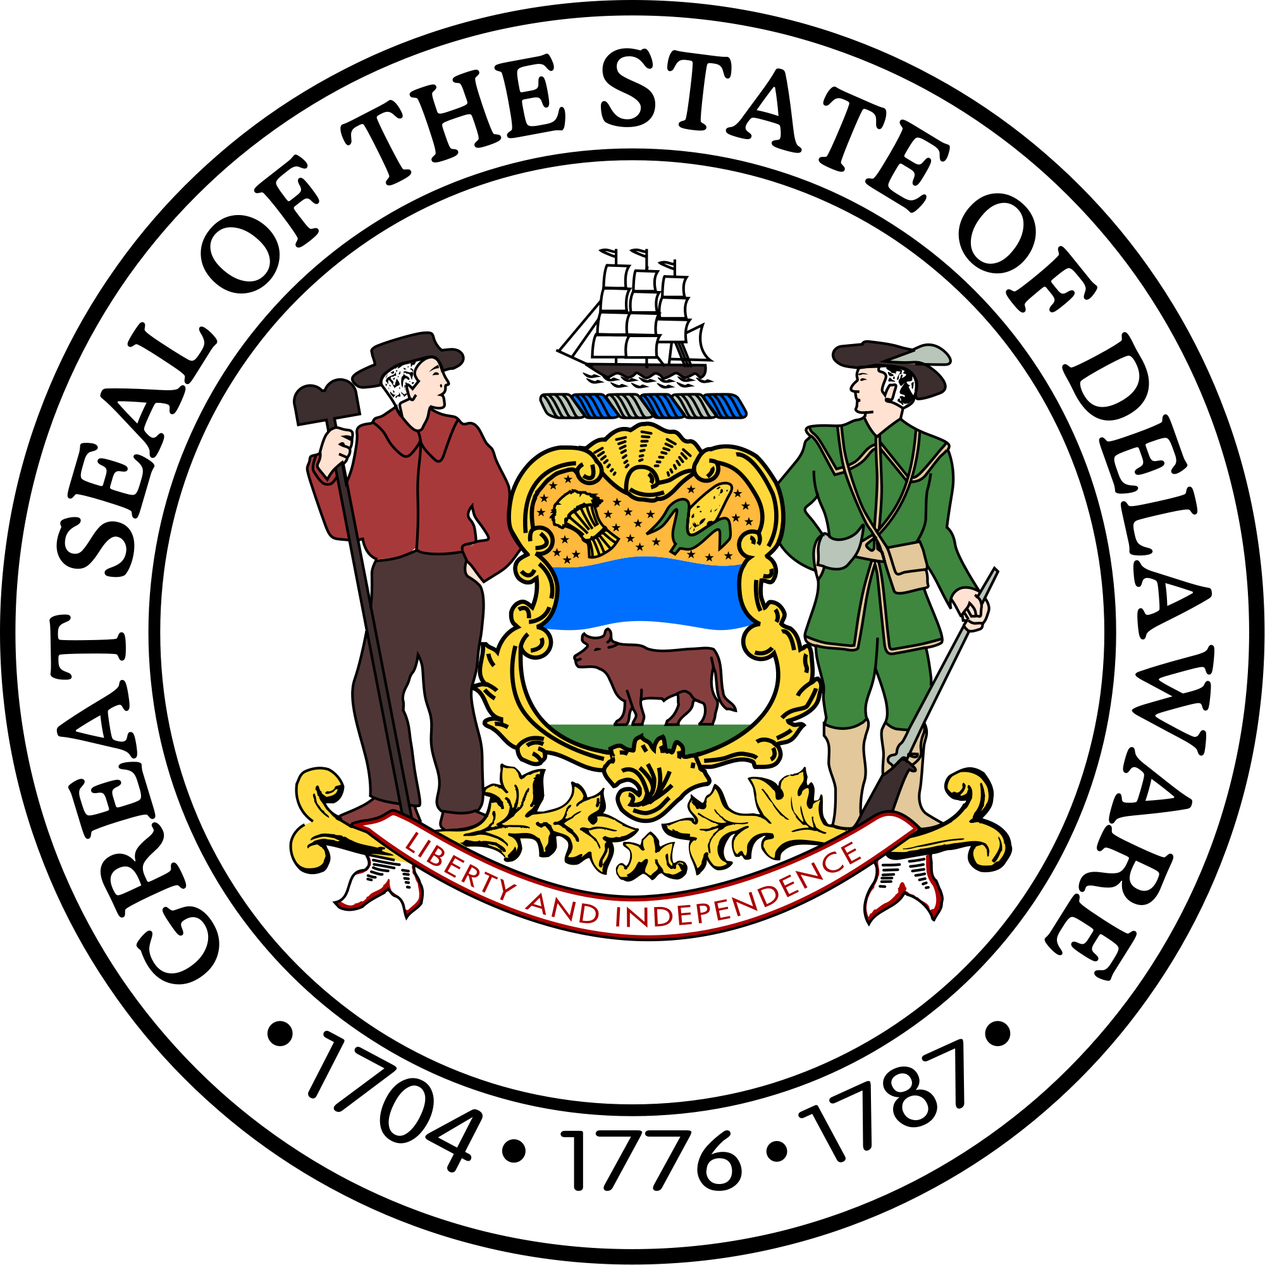
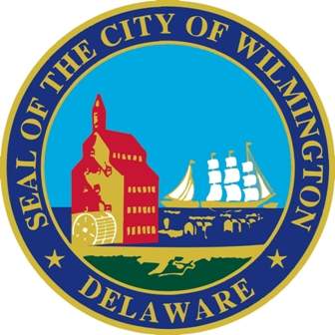
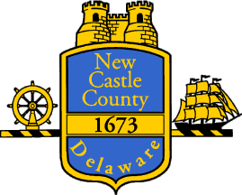
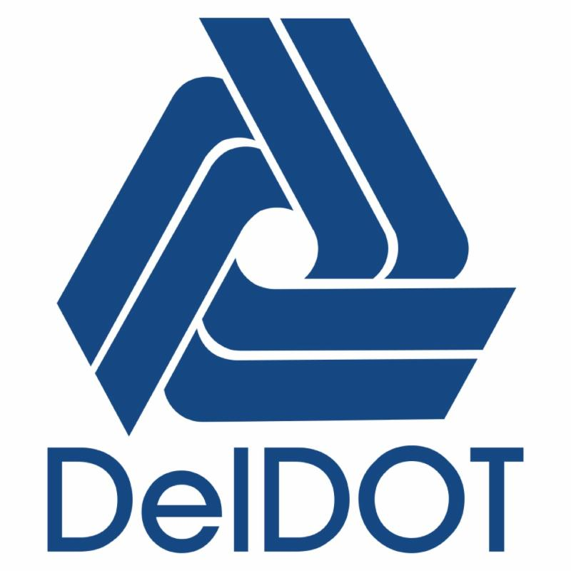
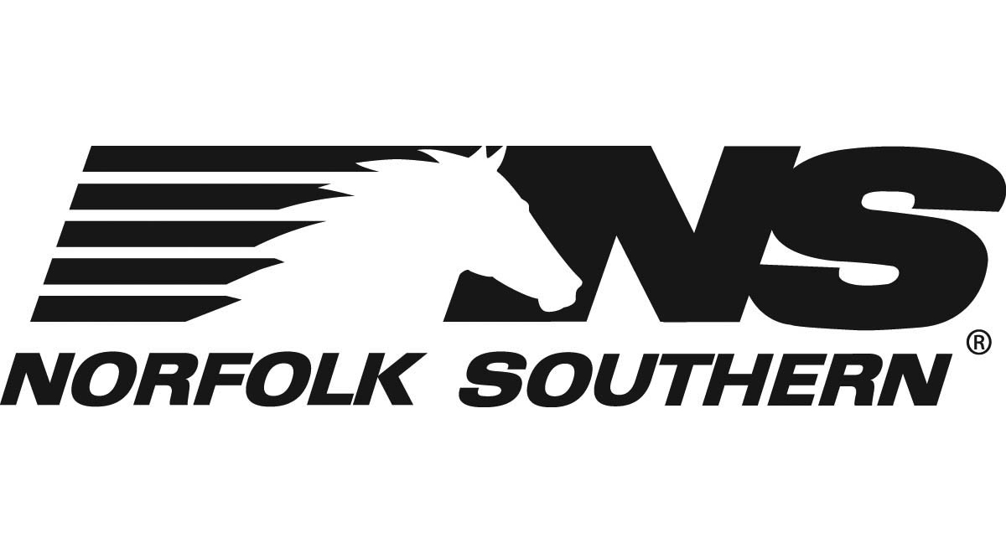
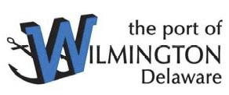
An assessment as to “Full Stakeholder” alignment becomes the primary issue for the private investor, with the required regulatory and permitting process “front and center”. A “Speed-to-Market” determination is essential.
©2016 Paul F. Richardson Associates, Inc.

Slide 10
And now, the “clock has started ticking”….again!
Start WHS and DMMP initiatives.
This planning and permitting process could easily run between $2m-$10m.
This is a critical path item.
The State of Delaware engages in discussions with Investors/Stakeholders regarding next steps to the RiverEdge Container Terminal Project.
Begin Alignment of Stakeholders,
Determine Competitive Landscape,
Determine role of existing DSPC facility, Edge Moor and,
Other public obligations associated with such a P3,
Engage other private stakeholder relationships which are integral to enterprise success.
The investor market has to have a clear vision as to:
Further “next steps” given past efforts,
The “speed-to-market” component and how it relates to competitive projects that are underway on the Delaware Bay.
©2016 Paul F. Richardson Associates, Inc.

Slide 11
CREATING FAMILY SUSTAINING EMPLOYMENT OPPORTUNITIES
 |  | Total |  |  |  | Total | State | State | State | Local | Federal
Port | TEU | Jobs | Direct | Indirect | Induced | Sales | GDP | Income | Taxes | Taxes | Taxes
Savannah | 2,944,678 | 352,146 |  |  |  | $66.9b | $32.4b | $18.5b | $1.4b | $1.1b | $4.5b
Charleston | 1,381,349 | 260,800 |  |  |  | $45.0b
NC Ports | 260,363 | 65,000 |  |  |  |  | $500m
Baltimore | 631,082 | 108,000 | 14,630 | 10,940 | 14,480 |  |  | $3.0b | $304m
Wilmington, DE | 329,200 | 16,877 | 2,203 | 444 | 1,673 |  |  |  | $31.0m
Norfolk | 2,230,008 | 100,244 |  |  |  |  | $12.b | $4.1b
NY/NJ | 5,445,108 | 279,200 | 170,770 |  |  | $37.1b |  | $11.6b | $1.6b |  | $3.6b
Jacksonville | 900,443 | 132,599 | 9,667 | 4,573 | 10,100 |  |  | $1.3b | $168m
Direct
Terminal Operators
Forwarders
Longshoremen
Warehousing
Construction
Government
Trucking
Rail
Tenants
Pilots
Tugs
Agents
Chandlers
Indirect
Goods/Services
M&R
Equipment
Utilities
Fuel
Insurance
Induced
Food
Shelter
Transportation
Medical
Retail
Apparel
©2014, PFRA Inc.
©2015, PFRA Inc.
©2016 Paul F. Richardson Associates, Inc.

